Slide 1
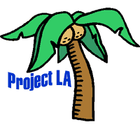
Types of Nouns:
Common & Proper Nouns

Slide 2
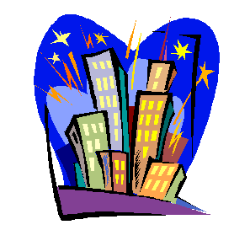


Common Nouns
Person, place, or thing. Common nouns are not capitalized.
  The city
  A policeman
  That newspaper

Slide 3
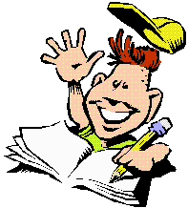
Proper Nouns
Name of a person, place, or thing. Proper nouns are capitalized.
  Lucknow
  Captain Sharma
  Hindustan Times

Slide 4
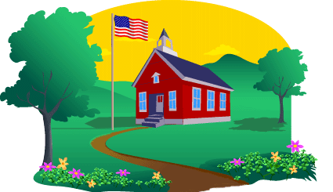
Is the underlined noun common or proper?
Priya visited the school last Friday.
Next Sentence

Slide 5
Common Noun
It is not capitalized.

Slide 6
Proper Noun
It is capitalized.

Slide 7
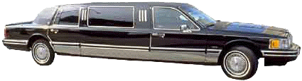
President Pranab Mukherjee rode in a limousine.
Next Sentence

Slide 8
Common Noun
It is not capitalized.

Slide 9
Proper Noun
It is capitalized.

Slide 10

The elephants and monkeys were at the Lucknow Zoo.
Next Sentence

Slide 11
Common Noun
It is not capitalized.

Slide 12
Proper Noun
It is capitalized.

Slide 13

All of Rahul’s paper is missing from his notebook.
Next Sentence

Slide 14
Common Noun
It is not capitalized.

Slide 15
Proper Noun
It is capitalized.

Slide 16
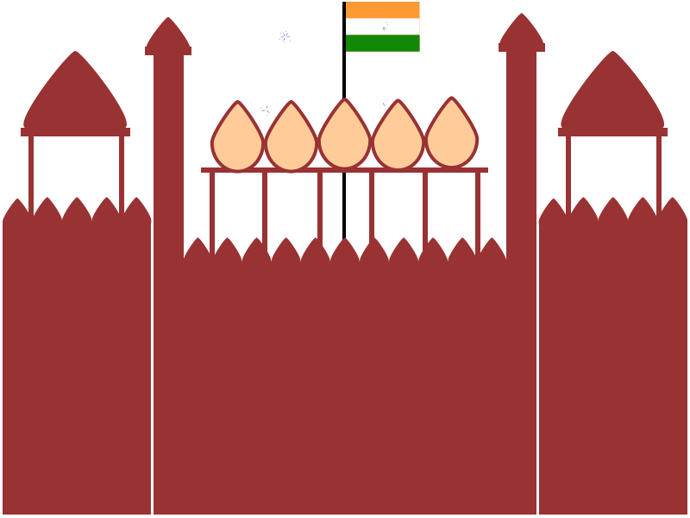
Rewrite using capital letters where required…
1)
My parents went to new delhi last sunday.

Slide 17
My parents went to New Delhi last Sunday.

Slide 18
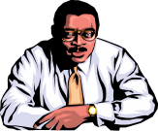
2)
Uncle raj used to live in agra.

Slide 19
Uncle Raj used to live in Agra.

Slide 20

3)
We heard the prime minister’s speech on television in january.

Slide 21
We heard the Prime Minister’s speech on television in January.

Slide 22
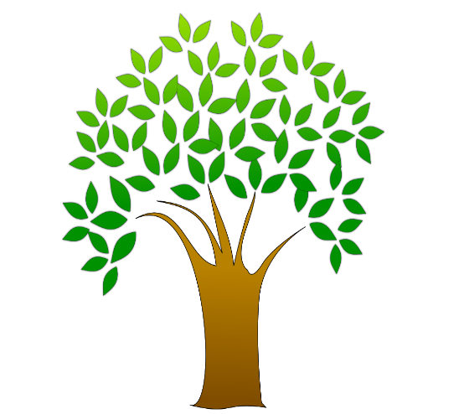
4)
Both rahul and anjali visited botanical garden.

Slide 23
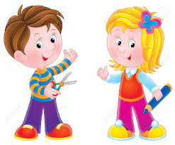
Both Rahul and Anjali visited the Botanical Garden.

Slide 24

Thank you.
MAIN

